Slide 1
Rapid Prototyping of Electric Circuits Using 3-D Printing
Gerardo Carranza
Mentor: John Swensen, Postdoctoral Associate
P.I: Dr. Aaron Dollar, John J. Lee Associate Professor of Mechanical Engineering & Materials Science
GRAB Lab

Slide 2
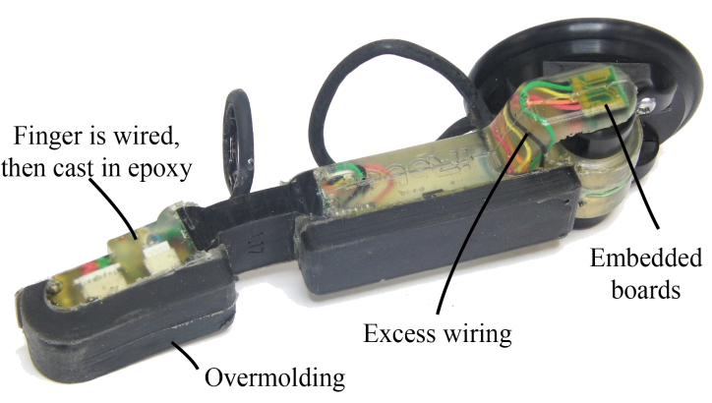

Embedded Circuits
Printed Circuit Board (PCB) Design
GRAB Lab
http://www.imaginant.com/images/HR-1100cCircuitBoard.jpg
Notes:
The fingers of the iRobot-Harvard-Yale (iHY) Hand, shown in Figure 1, have low cost encoders, accelerometers and contact sensors…
Solutionembed traces directly into the 3-D printed body of the finger

Slide 3
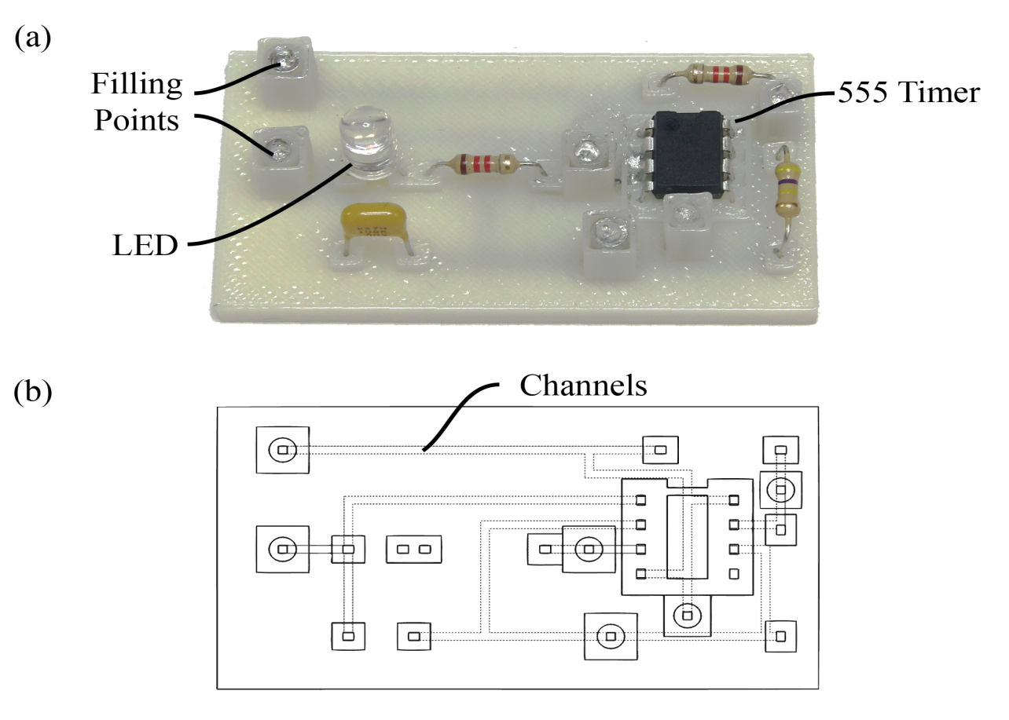
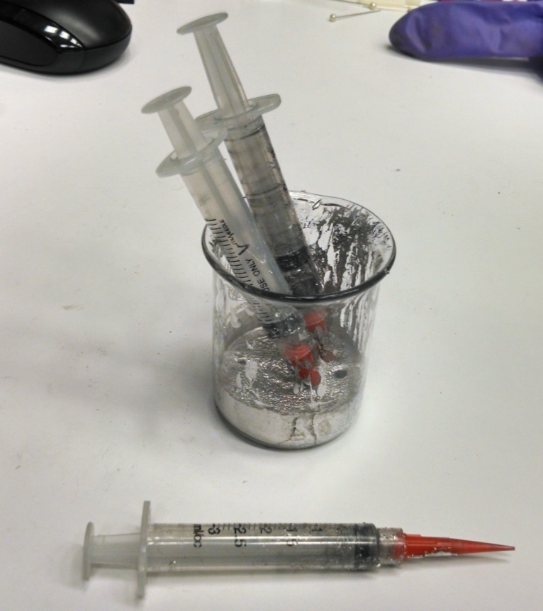

Prior Work
Cerrolow 136
57.8 °C melting point
Minor net volume change
Brandon Araki, 2014, An Injection-Based Method of Embedding Electronics in 3D Printed Parts
Notes:
That my research this summer is building upon
Manually designed a single layer circuit
Channels that start at an injection point at branch out to through-holes, or pads, located at varying distances from that injection point.
All of the circuit components were placed and then the liquid metal Cerrolow 136 was injected.
The conductive material chosen to fill in the electrical traces of the circuit…

Slide 4
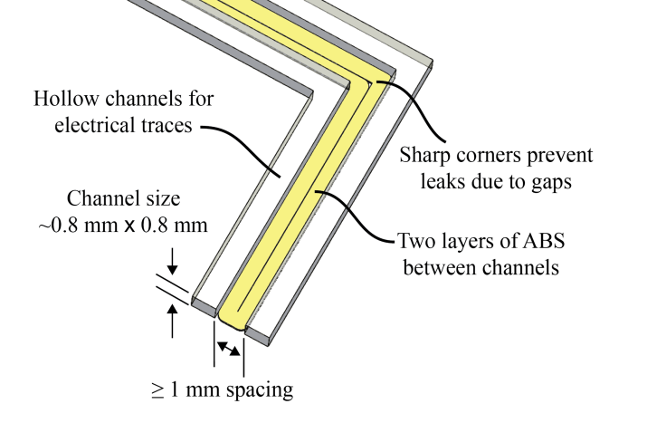
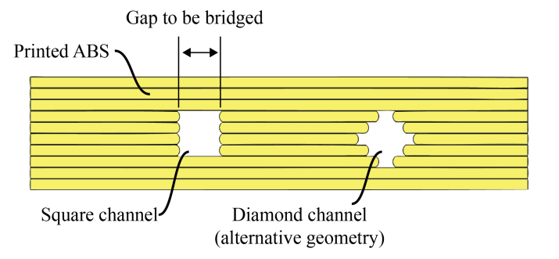
Creation of Channels
FDM Printer: Stratasys Fortus 250mc
Brandon Araki, 2014, An Injection-Based Method of Embedding Electronics in 3D Printed Parts
Notes:
All these design considerations were taken into account in the manual design of the 3-D model for the electric circuit

Slide 5
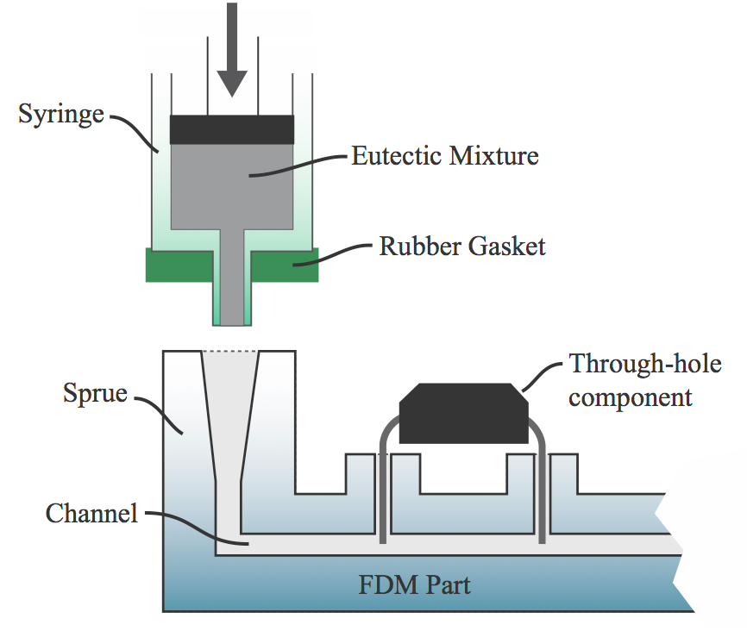
Injection-Based Method
Brandon Araki, 2014, An Injection-Based Method of Embedding Electronics in 3D Printed Parts

Slide 6
Questions
Can we automate the manual process of 3-D printable circuit design?
Can we design a method that solves the metal spillage problem?
Notes:
For the purposes of rapidly prototyping 3-D robotic parts alongside embedded electric circuits, is not convenient

Slide 7
Proposed Method
Define Circuit Board Layout
Extract and Interpret PCB Information
Create 3-D printable circuit

Slide 8
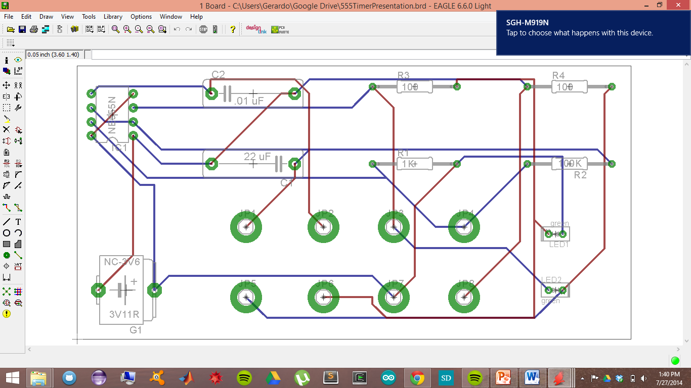
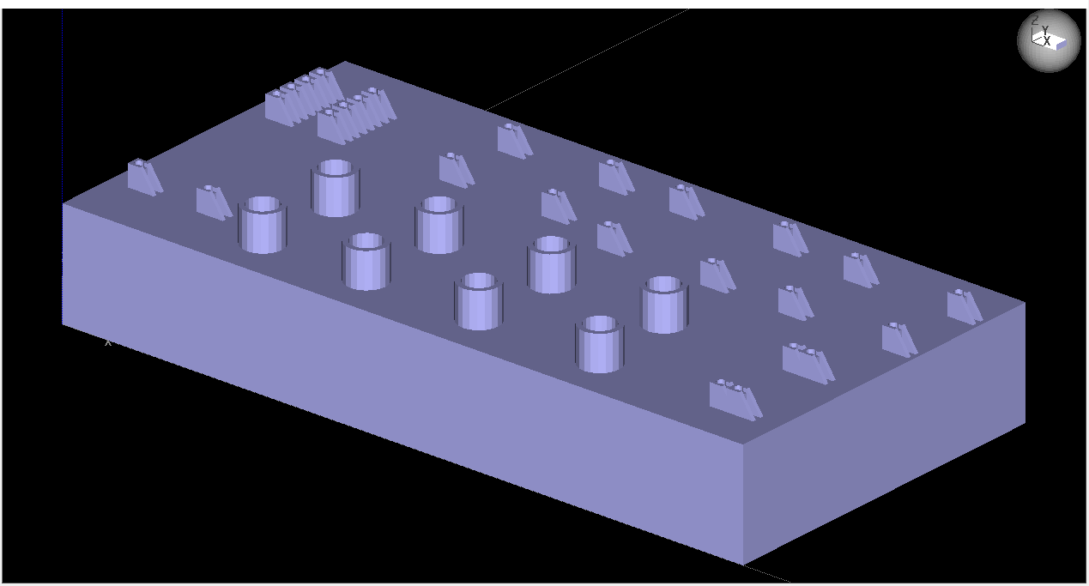
Goal of Proposed Method

Slide 9
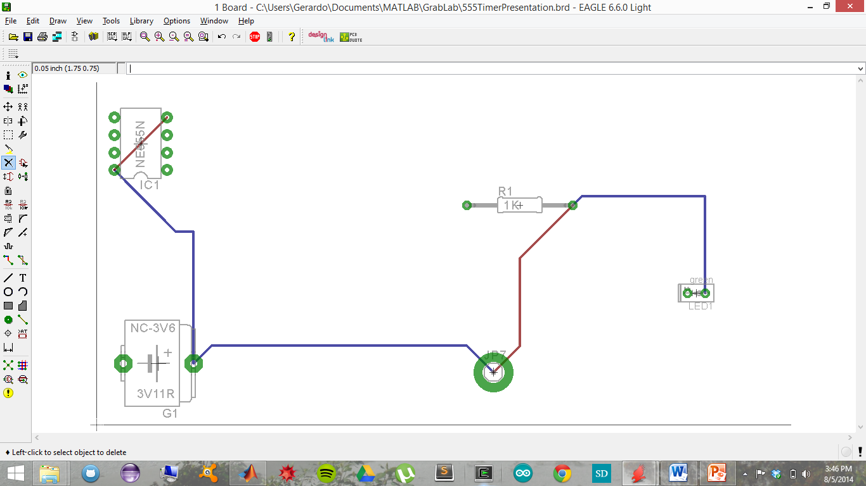
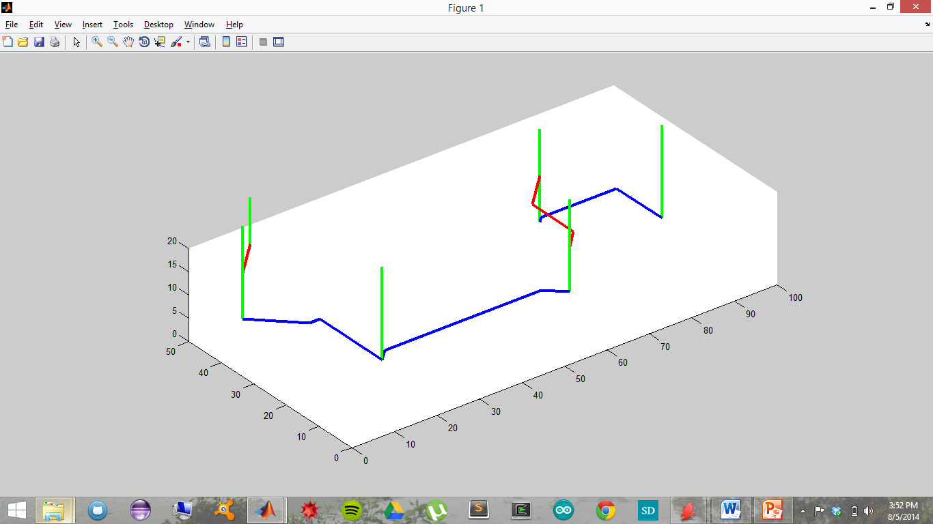
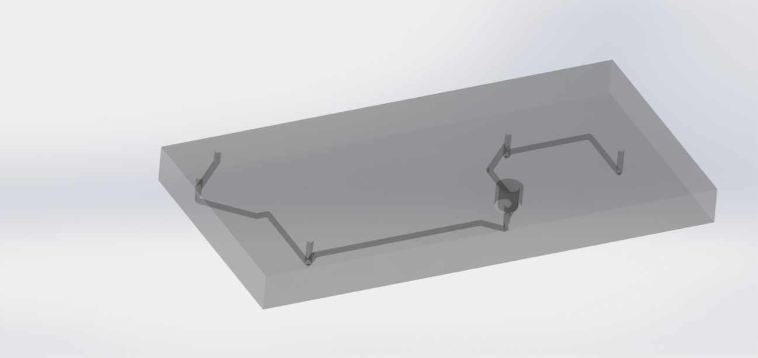
Tree Structure
Injection Point 7
BATT Pad 2
R1 Pad 2
555 Pad 4
555 Pad 5
LED1 Pad 2
Through-hole
Injection Point
Notes:
The design of this tree structure will then allow us to gain insight into how…

Slide 10
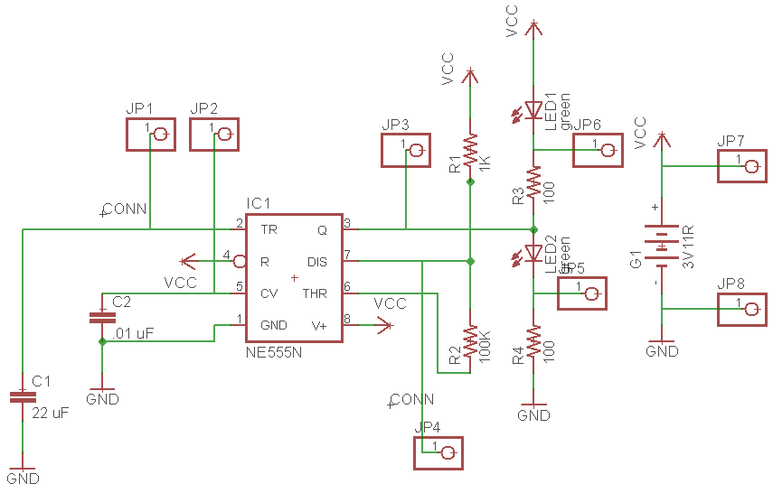
EAGLE PCB
Easily Applicable Graphical Layout Editor for Printed Circuit Boards

Slide 11
EAGLE PCB
Notes:
Chosen circuit board that of a 555 Timer.
Traditionally, it is at this point in the process that…
AutoRouter Capabilities

Slide 12
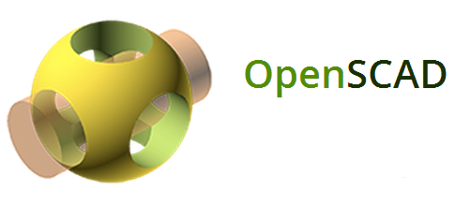
Computer Aided Design
Computer Aided Design (CAD) software applications used to create 3-D models
Advantages:
Programmable
Export STL file format

Slide 13
.BRD
XML
.OPENSCAD
.STL
MATLAB
.BRD
.STL
MATLAB

Slide 14
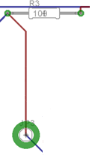
PCB Information
Through-hole/Pad
Ending Wire Coordinate
Injection Point “JP3”
Starting Wire Coordinate
Top Layer
Bottom Layer

Slide 15
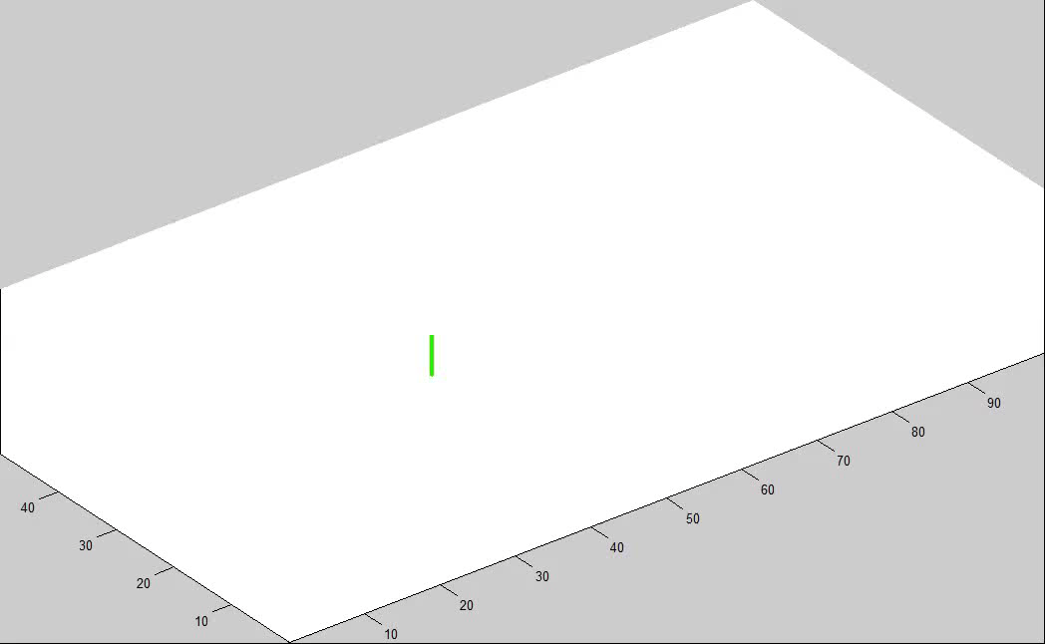
MATLAB
Notes:
Now, the information about the wire paths from EAGLE PCB could have been extracted in any order for the creation of the channels. This would answer our first question. However, to answer our second question it was necessary that we structure the information from EAGLE PCB in a way that

Slide 16
Tree Structure
Injection Point 7
BATT Pad 2
R1 Pad 2
555 Pad 4
555 Pad 5
LED1 Pad 2
Through-hole
Injection Point
Notes:
The design of this tree structure will then allow us to gain insight into how…

Slide 17
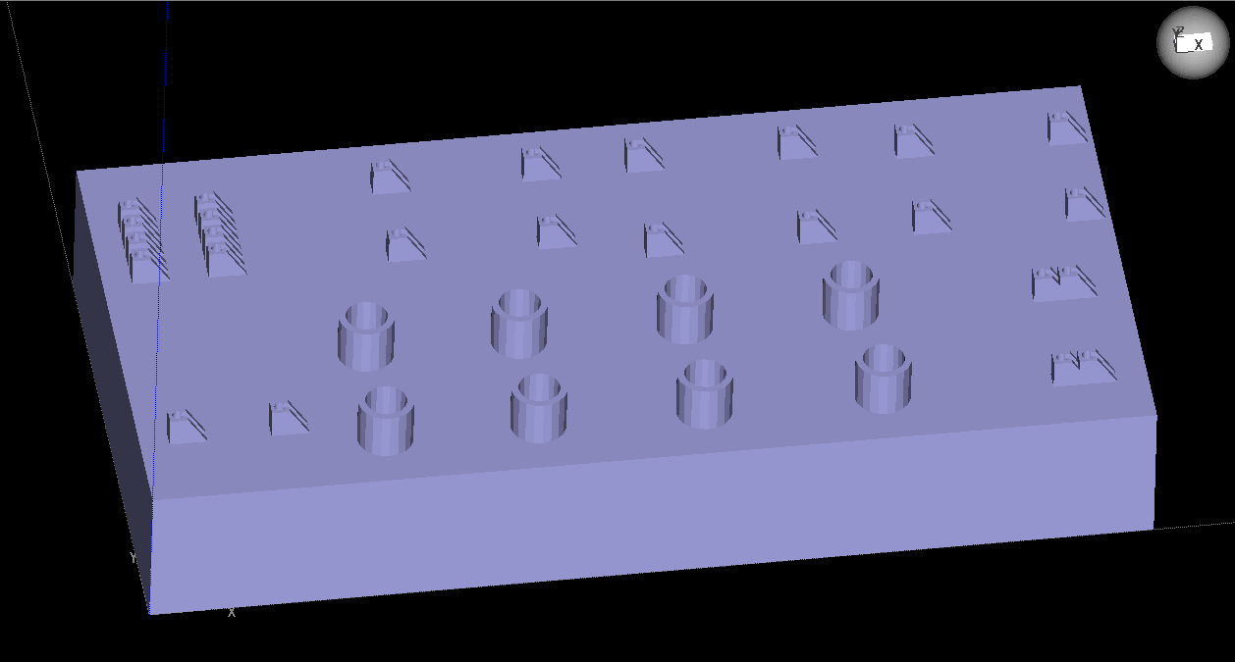
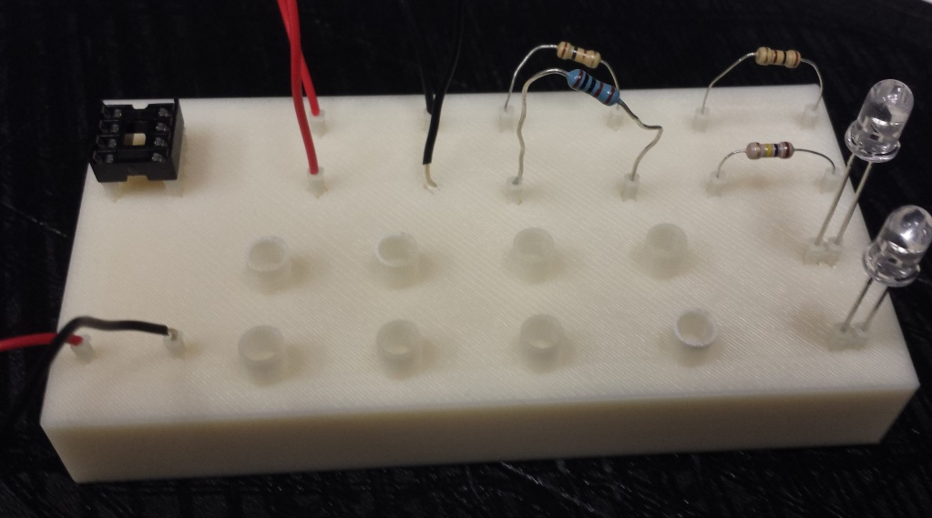
Automation Successful

Slide 18
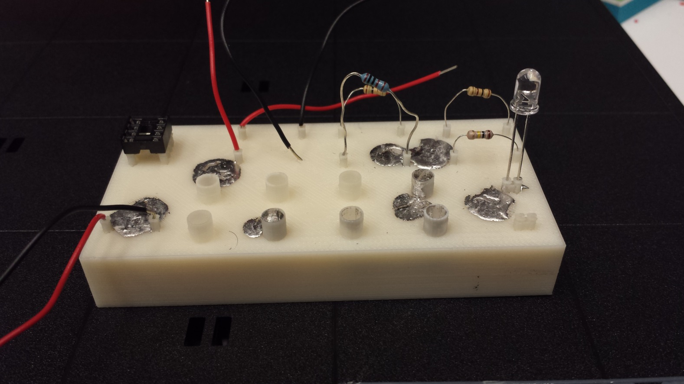
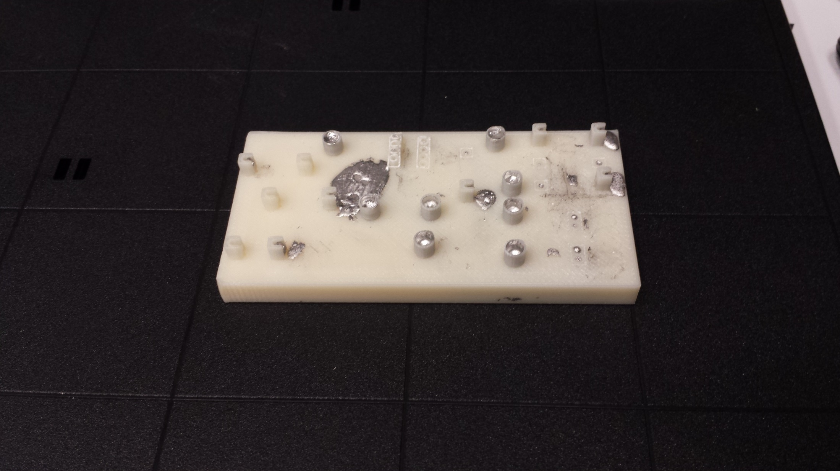
Injection Based Method

Slide 19
Future Work
Expansion to 3+ layered circuits
Trials with Different Types of Printers
Automation of Injection Points
Modification of Tree Structure Model

Slide 20
Acknowledgements
STARS Summer Research Program
Howard Hughes Medical Institute (HHMI)
The Goizueta Foundation
Yale College
Dr. Moreno, Nr. Nelson, and Dr. Purushothaman
GRAB Lab (Aaron Dollar)
John Swensen, Postdoctoral Associate
Raymond Ma
Tom Bu

